Slide 1



Hotel Review Sentiment Analysis Project
A Natural Language Processing (NLP ) Based Approach
This project focuses on analyzing hotel reviews using NLP to classify them as Positive, Neutral, or Negative. By leveraging text preprocessing, TF-IDF, and machine learning, it helps automate sentiment analysis and supports better decision-making for hotel businesses.
Presented By – Ashish Singh

Slide 2












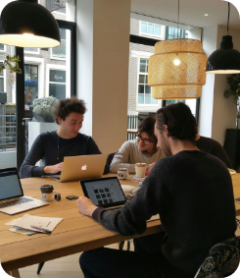


Problem Statement
Why This Project?
Enhancing Guest Experience with AI
Smarter Booking Decisions
Bridge Between Feedback & Action
Target Audience
Boosting Hotel Service Quality
Specify who will benefit from this project (e.g., hotel managers, travelers, researchers).
Hotels can identify areas of improvement through collective sentiment feedback.
By analyzing reviews at scale, hotels can quickly act on feedback and improve service quality.
Helping customers choose hotels based on sentiment-driven summaries instead of lengthy reviews.
Enables hotel managers to respond quickly to guest sentiments.

Slide 3


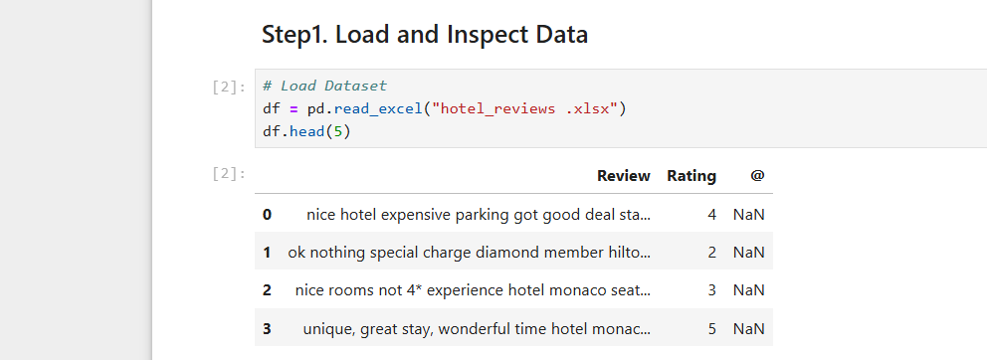



Dataset Overview
Dataset Name
Data Types
01
Hotel Review Dataset
05
Categorical & Numerical
Total Rows
02
20,000+ reviews
Total Columns
03
2
Target Variable
04
Rating (Positive, Neutral, Negative)

Slide 4
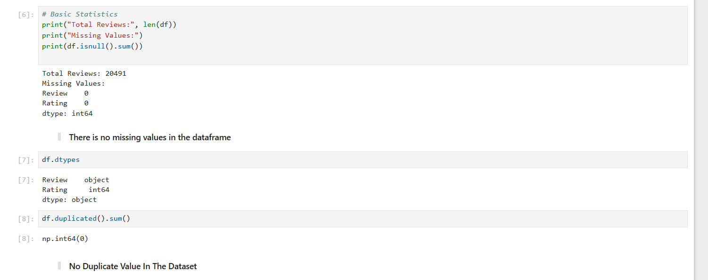





Exploratory Data Analysis (EDA)
Missing Columns
There are no columns in which the values are missing .
Duplicates Records
There is no duplicate values found in the data set .
Data Source
Data was taken from the in the excel format.

Slide 5


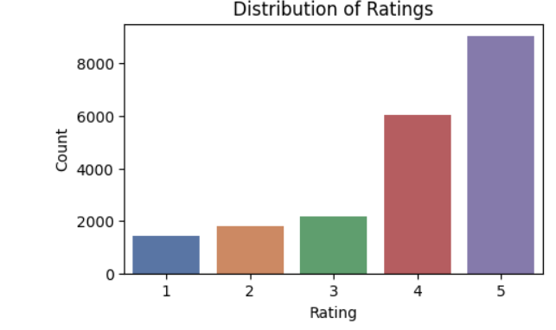

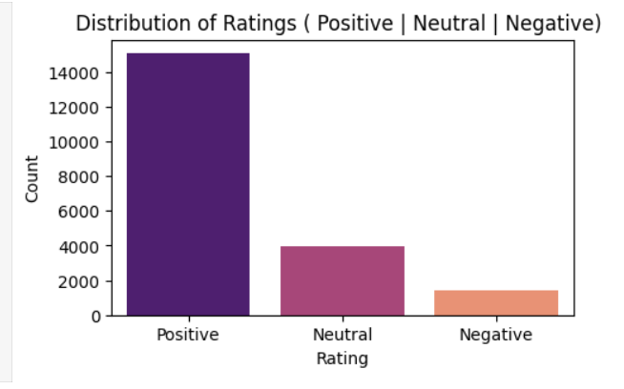
01
Sentiment Analysis For Rating
Rating Order Before
Before Converting Rating to Categorical the rating was distributed in the Numerical order of 1 to 5 order .
02
Rating Order After
After Converting Rating to Categorical the rating was distributed in the order of Positive , Neutral , Negative .
03
Rating → Sentiment:
4-5: Positive
2-3: Neutral
0-1: Negative
Encoded: {'Negative':0, 'Neutral':1, 'Positive':2}

Slide 6





Text Cleaning And Preprocessing
01
02
Convert text to lowercase
Remove punctuation and special characters
Standardizes all text to avoid case-sensitive mismatches.
Cleans text by eliminating irrelevant symbols and noise.
03
04
Tokenize words And Remove Stopwords
Perform stemming/lemmatization
Splits sentences into individual words for easier processing.
Removes common words (like “the”, “is”) that carry little meaning.
Reduces words to their root form to unify similar terms.

Slide 7
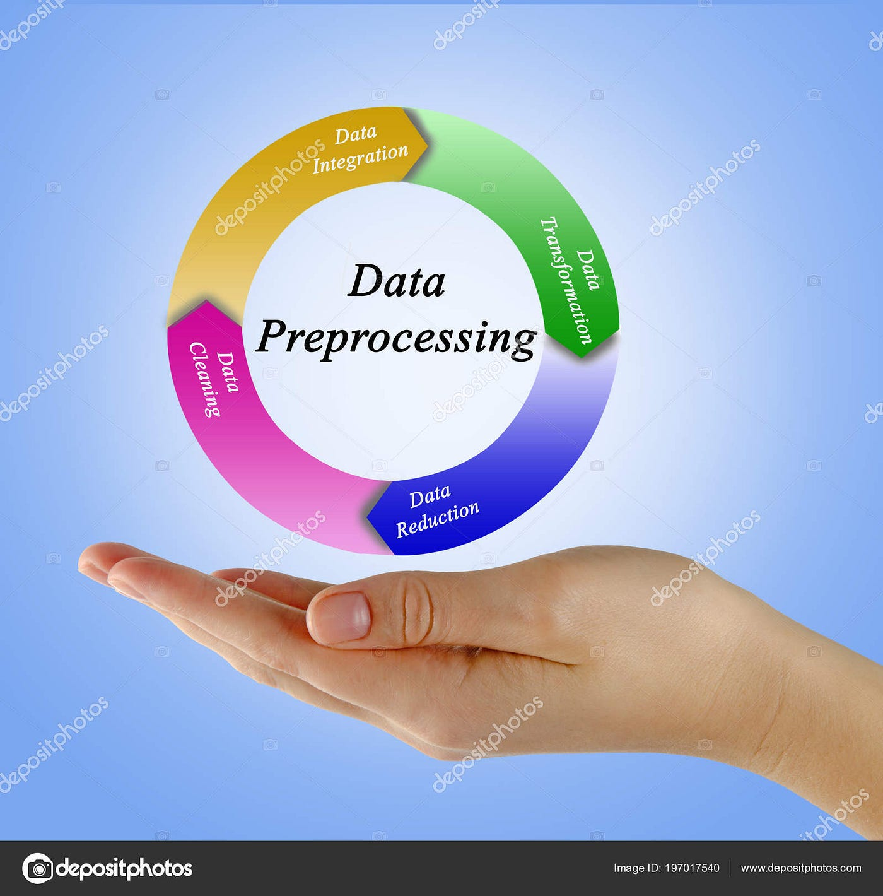
Data Preprocessing
01
Train Test Split
Apply Train Test Split
Train-Test Split (e.g., 80%-20%)
80% Training Set (X_train, y_train)
20% Testing split Set (X_test , y_test)
Ensured randomness with random_state=42
02
Enhanced Quality
Presentations generated by the platform receive higher engagement rates and positive feedback, demonstrating improved audience connection.
02
Word Embeddings
04
Converts text data into numerical format for model input.
Tfidf = TfidfVectorizer (max_features=5000)
Term Frequency (TF) counts how often a word appears in a document.
Helps the model focus on unique and meaningful words in reviews
Business Growth
Companies leveraging Presentations.AI have noted an increase in successful pitches and proposals, contributing to significant revenue growth.

Slide 8

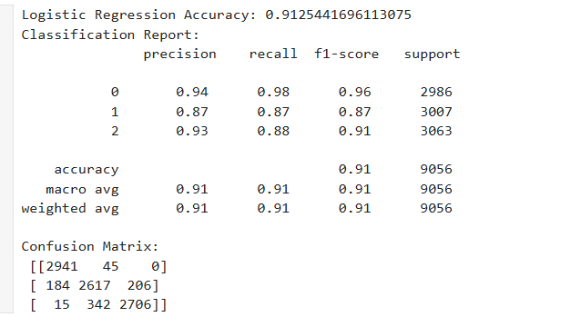








Model Selection And Training
Model Selection
Accuracy
Metrics
Save the Model
Logistic Regression performed best on this dataset
Model Accuracy is ~91%
The model demonstrates high reliability in predicting sentiment correctly.
Precision, Recall, F1-Score
Used to ensure balanced performance across all sentiment classes.
Joblib is used to efficiently save and load machine learning models for deployment.

Slide 9



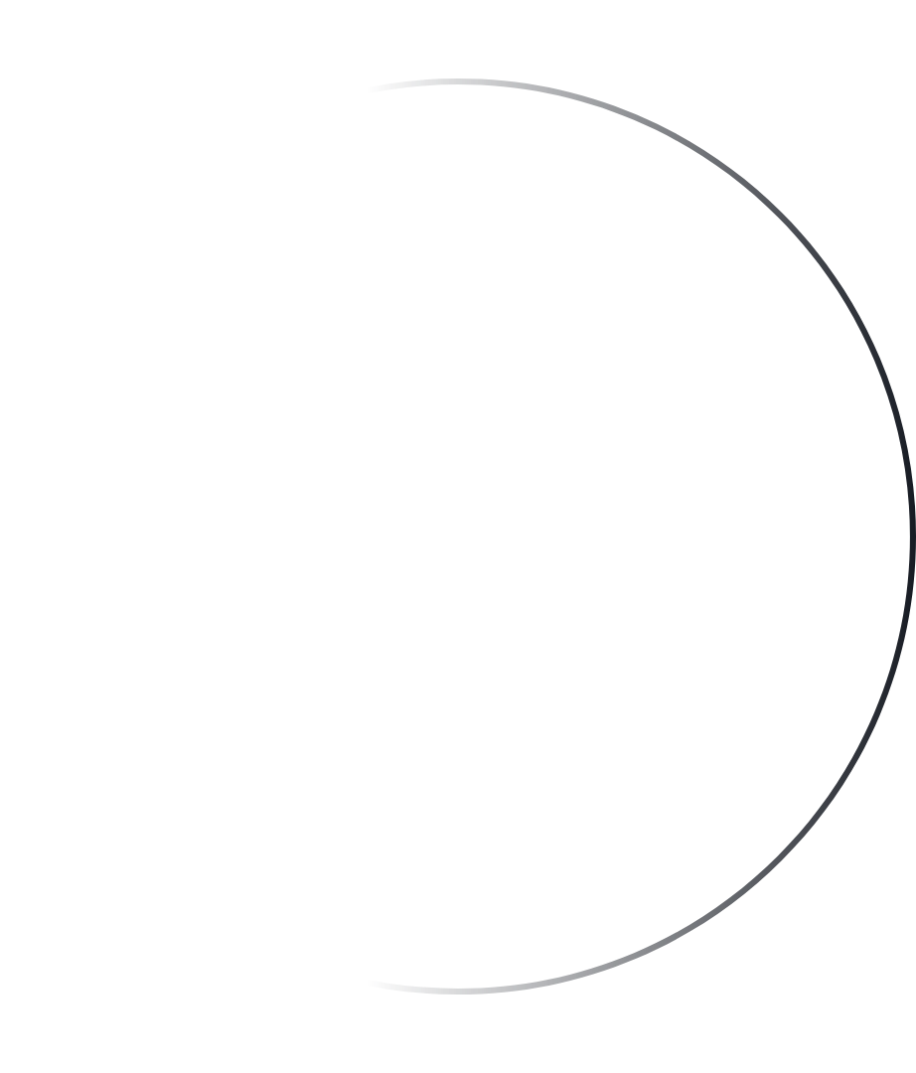



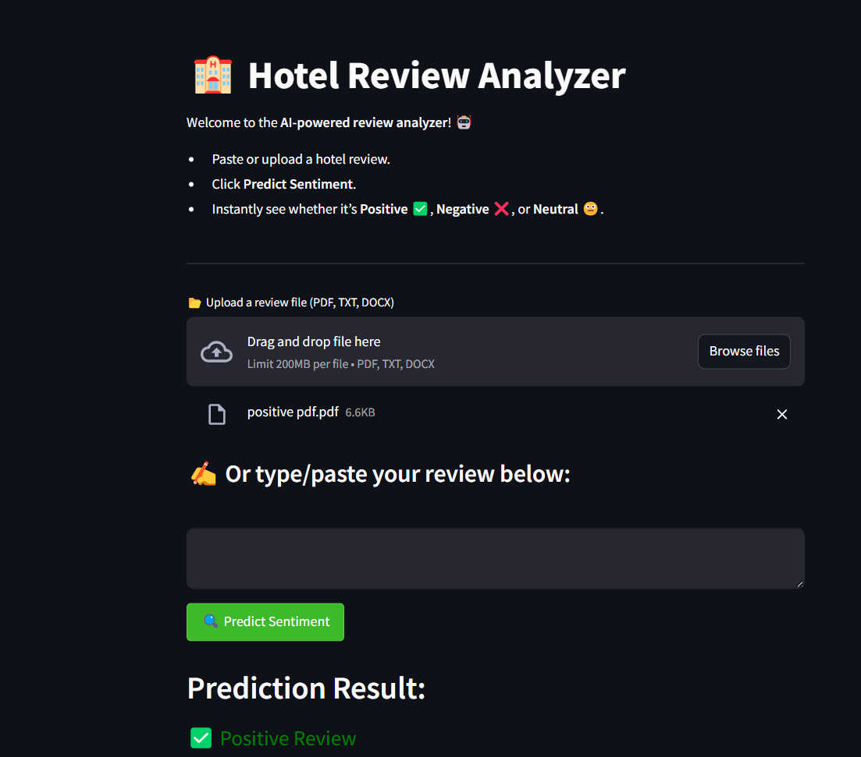




Deployment of the Model
Model Developed Using Streamlit
The app was built with Streamlit for an interactive and responsive web interface.
Frontend: Streamlit Backend: Python
Libraries Used: streamlit, pandas, scikit-learn, joblib, nltk, re, numpy
Deployed on Streamlit Cloud
Hosted on Streamlit Cloud, a free and easy-to-use platform for deploying Python apps online.
Always Live & Shareable
GitHub Integration
Auto Deployment on Push
Instant Sentiment Prediction
Model predicts reviews based on inputs.
Prediction Output:
Positive, Neutral, Negative

Slide 10


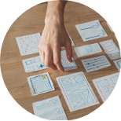



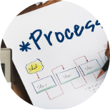

Real-World Applications
Automated Review Sorting
Performance Evaluation
Categorizes reviews as Positive, Negative, or Neutral for quick analysis.
Tracks staff or department performance through customer feedback sentiment.
Competitor Analysis
Reputation Management
Analyzes competitor reviews to discover industry trends and service gaps.
Helps hotels quickly respond to negative feedback to maintain online reputation.
Targeted Service Improvements
Personalized Marketing Campaigns
Identifies areas like food, service, or cleanliness that guests often mention.
Tailor promotions based on guest preferences and sentiments.

Slide 11





“Check out my work on GitHub!”
“Live App Check Hotel Review!”

